Slide 1

JobsDB Webscraping Project
Kent, Daniel, Ian, eddie

Slide 2
OUR AIM:
Gather job posting data from JobsDB.com
Webscrap job posting data over the past 30 days
Focus on data science related job openings
Visualize hiring insights from various perspectives: location, job title, skill set in demand etc.

Slide 3
BUSINESS VALUES:
Help job-seekers interested in data science field gain job market insights:
Where are the most common working location ?
What are the most required skillsets/qualifications ?
Which companies are the top employers in the market ?

Slide 4
DATA COLLECTION:
All our data are collected from JobsDB.com:
Web scraping tool: BeautifulSoup
Library used: Pandas, Seaborn, Matpolib

Slide 5
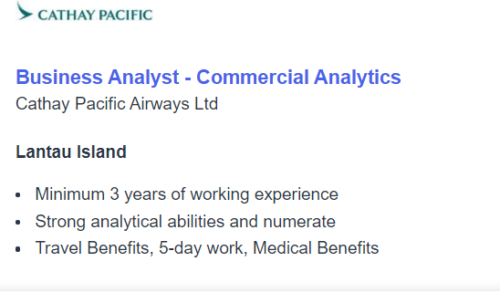
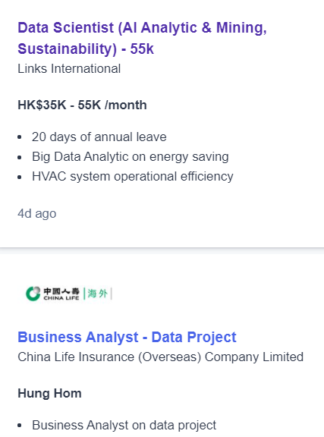
DATA PREPROCESSING:
Total of 5130 job postings, pinpoint by 7 categories:
Date of post, job title, company name, location, industry, years of experience, requirements, job description
Date of post : convert strings into integers
“3 years of experience” 🡪 “3”
Job Title:
Remove irrelevant job positions such as Wealth Management, Software Engineer
Filter and group job titles in 4 types:
Data Analyst, Data Scientist, Data Engineer, Business Analyst

Slide 6
ANALYSIS

Slide 7
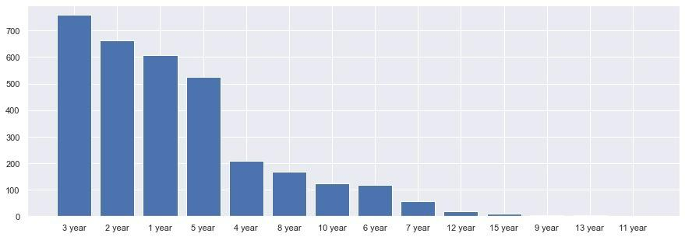
JOBS BY YEARS OF EXPERIENCE:

Slide 8
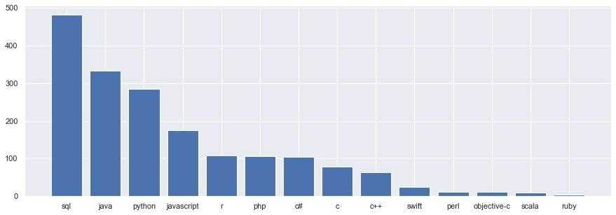
JOBS BY PROGRAMMING LANGUAGE

Slide 9
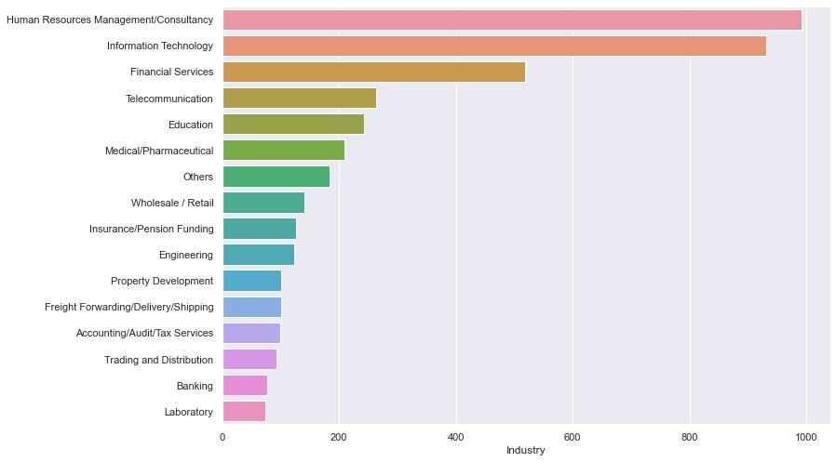
JOBS BY INDUSTRY:

Slide 10
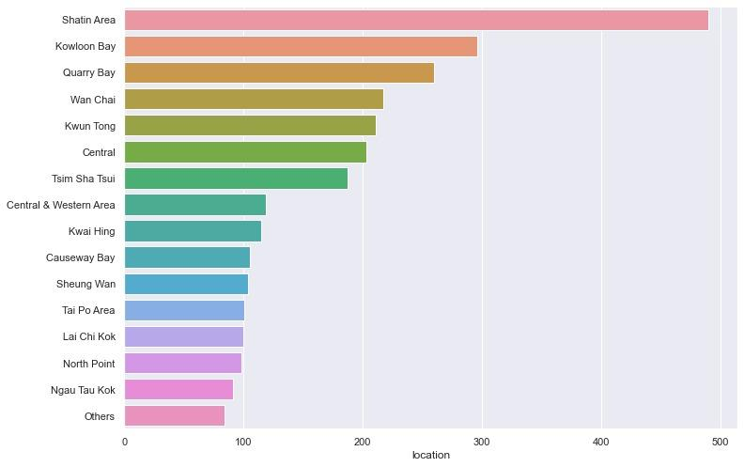
JOBS BY LOCATION:

Slide 11
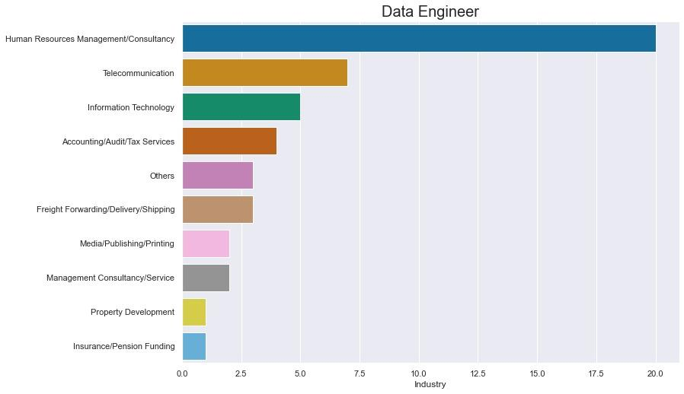
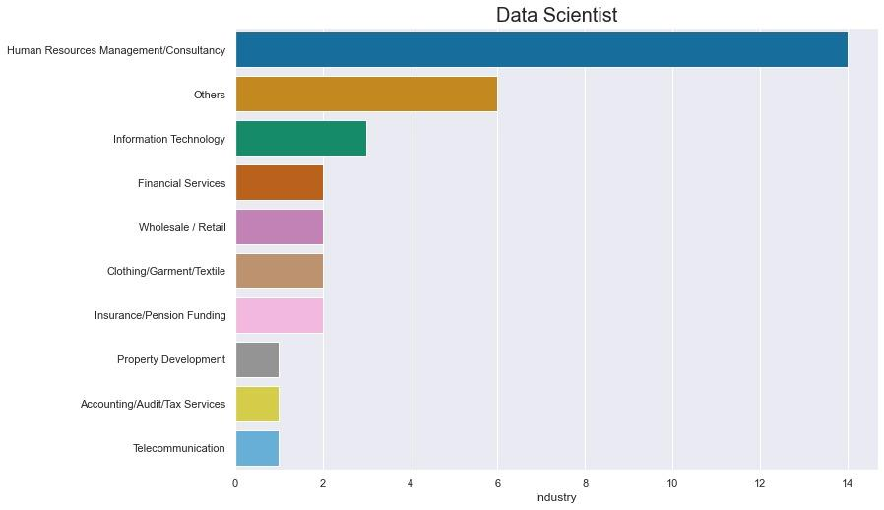
Data Engineer:
Telecommunication
Information Technology
Accounting
Data Scientist:
Information Technology
Financial Services
Wholesale / Retail

Slide 12
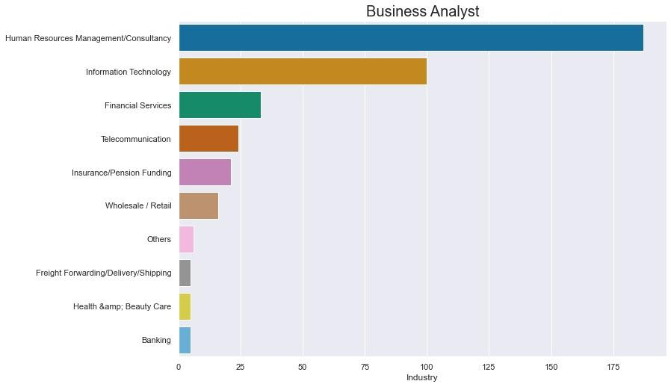
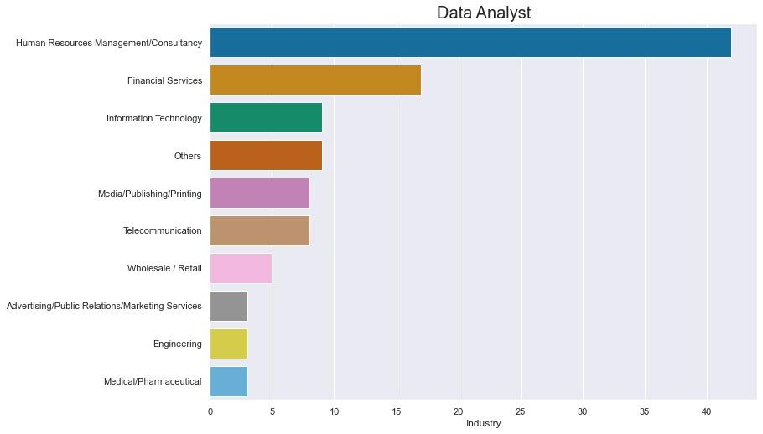
Business Analyst:
Information Technology
Financial Services
Telecommunication
Data Analyst:
Financial Services
Information Technology

Slide 13
CHALLENGES & NEXT STEPS:
Challenges:
Career sites are usually encrypted or has security measure to discourage web scrapping
Next Steps:
Gather more comprehensive data set
Ctgoodjobs.com / Linkedin.com / Cpjobs.com
Gather data over a long time period: quarterly, yearly
Include salary information with relevant job posts

Slide 14
CONCLUSION
Key Observations:
Most prominent working location: SHATIN!
Technical requirements for Data Analyst, Data Scientist, Data Engineer are much higher than Business Analyst

Slide 15
CONCLUSION:
Data Engineer:
BI / ETF
Java, Python, MySQL, Python
Data Scientist:
Tableau, Python, MySQL, Hadoop
Data Analyst:
ETL, Oracle, Java, Excel, Linux
Business Analyst:
Seems no particular pattern.

